Slide 1
CREATE DATABASE IN AWS

Slide 2
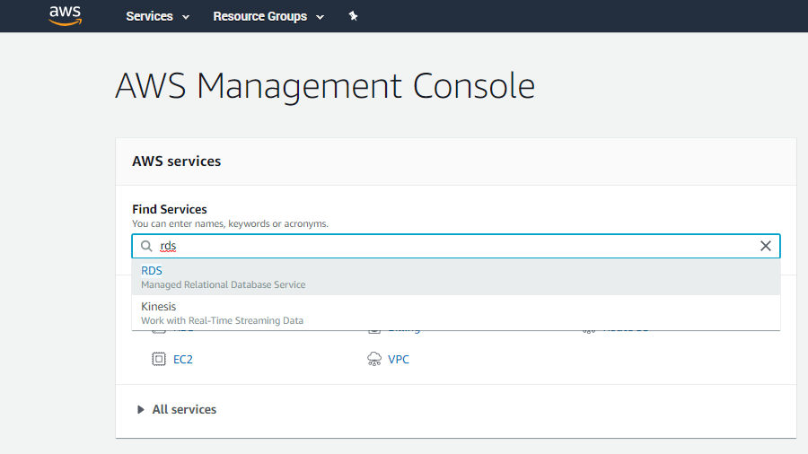
After logging in to AWS Console.
Search ‘RDS’

Slide 3
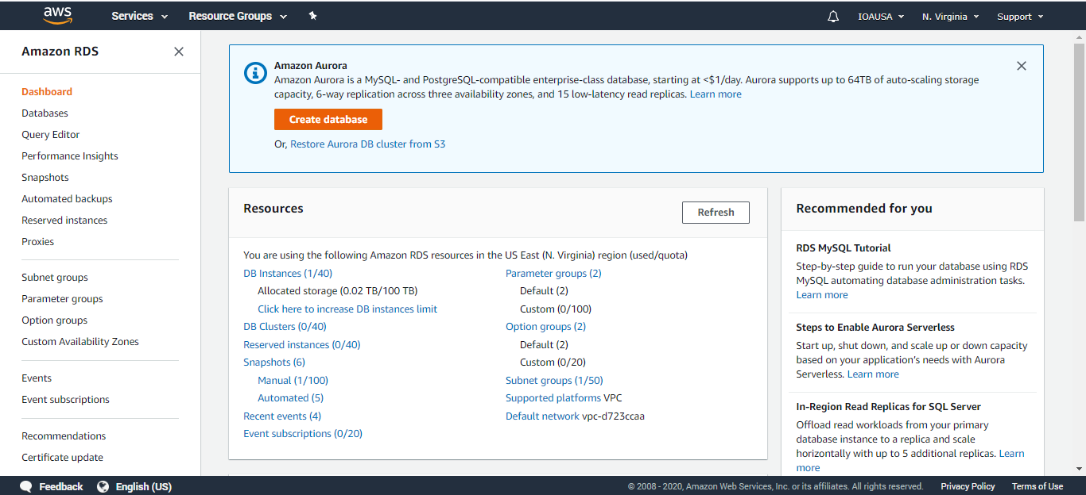
Click ‘Create Database’

Slide 4
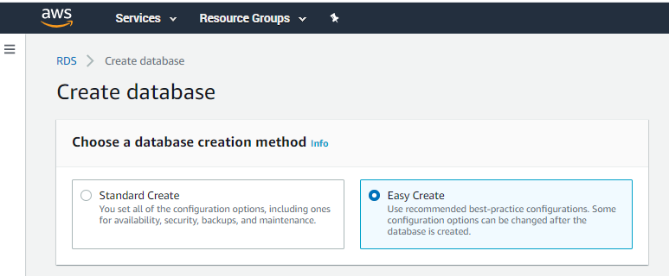
Choose ‘Easy Create’ as database creation method

Slide 5
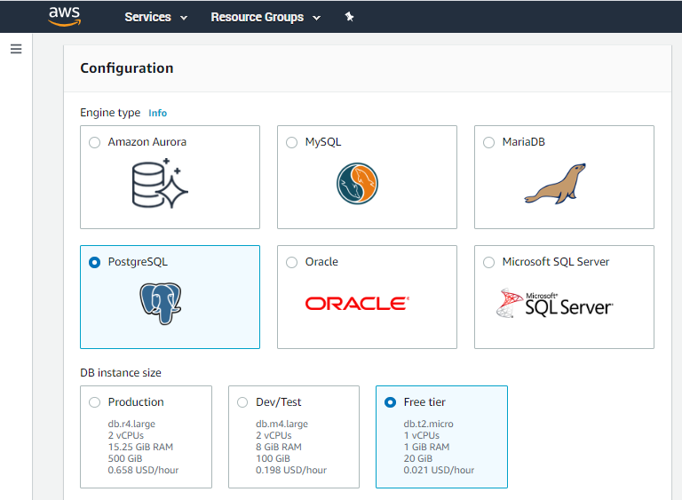
Choose ‘PostgreSQL’ as Engine Type
& ‘Free Tier’ as DB instance size

Slide 6
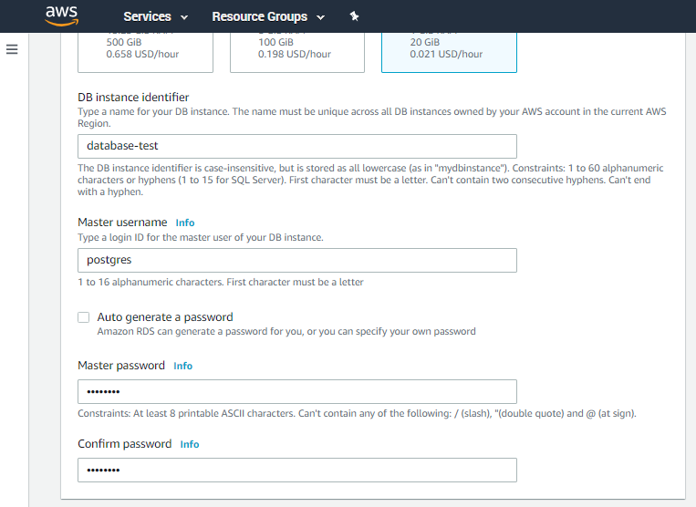
Choose DB instance identifier, Master username and Master password. Then Click ‘Create Database’

Slide 7
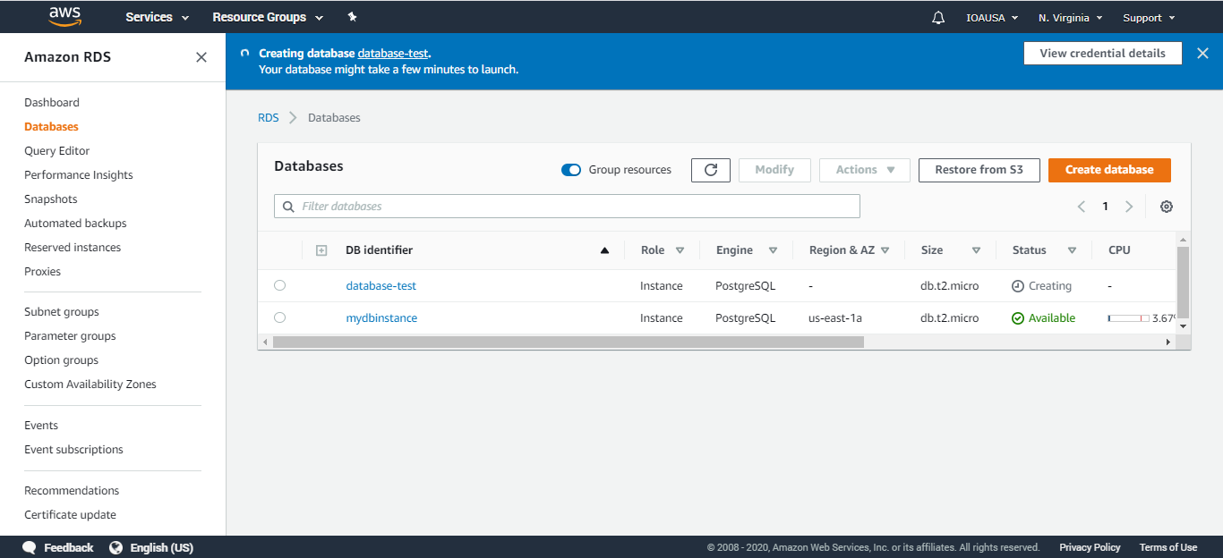
It will take few minutes for the services to start running.
Once the status turns as ‘Available’,
Click the DB identifier name to see its details.

Slide 8
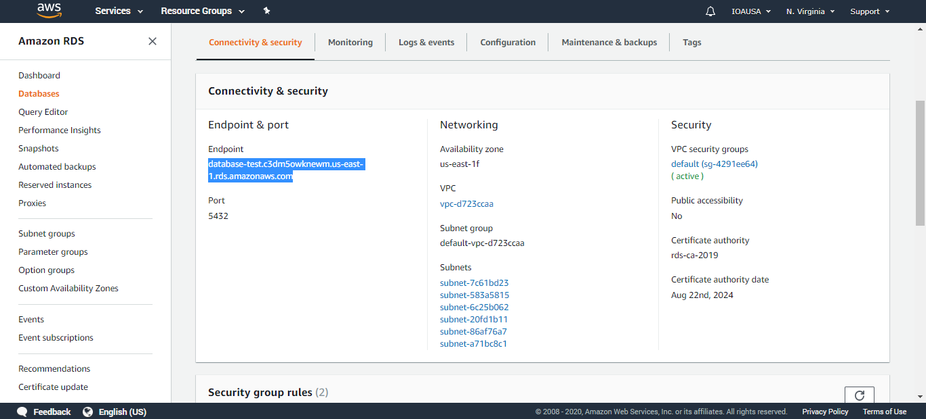
Use Endpoint as ‘Host’ & Port no. ‘5432’
while connecting to the Database from your code

Slide 9
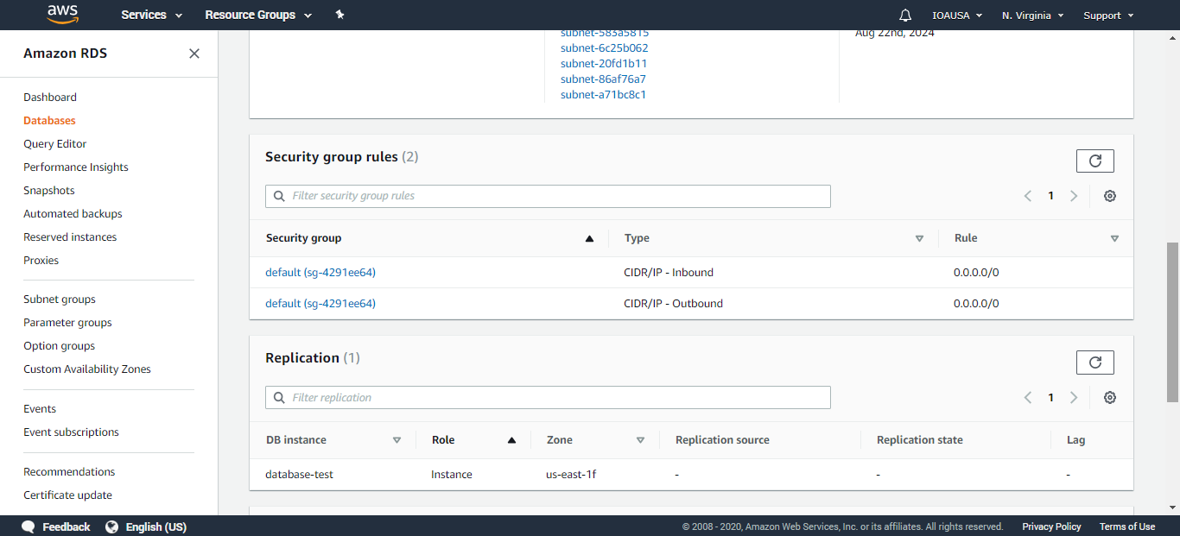
Keep Inbound IP address as ‘0.0.0.0/0’ (default)
to connect with the database from any device
Or
Replace ‘0.0.0.0/0’ to your ‘public IP address’ to make connection with your device
Click to update IP Address

